Slide 1
Synopsis Presentation
on
SCHOOL FINDER
Guided By:
Mr. Ambrish Shrivastav
Presented By:
Kuldeep Salve
Ishra Ali
COMPUTER SCIENCE AND ENGINEERING DEPARTMENT
SESSION : July- Dec 2019

Slide 2

Table of Content
Abstract
Introduction
Objective
Problem Domain
Solution Domain
Requirements
Reference

Slide 3
Abstract
This Online school finder system is the system designed especially for those people who want to search a particular school on the basis of its type, courses offered and location of the school. In this application we can search schools easily and get their details in just a second. If end user wants to search a best school in a city, he or she can search here. In this application the admin collect the information from all schools and upload on the site. The admin can change or update the details of a school. From this application school gets an idea about how many people search for their school, from where the client is. In this business analysis plays a role. The detail is updated by admin to every school .

Slide 4
Introduction
The application is focused on student’s bright future. If they didn’t get the best school they didn’t go ahead because the each and everything a student must learn from their school. So this application helps parents to find good school for their child. It is mainly very helpful for the students and parents who want to take admissions in the schools after some grade for some reason. It is also useful for locating the nearest school from the area of living from his home. This is the most important decision for parents to find the good schools for their child. In this application parents get easily find school of their choice. This application is good for schools too.

Slide 5
Objective
The main objective is to overcome the problem of visiting various Schools for admission purpose.
Easily finding details about various school at single platform.
Schools will come to know the parents expectations, with the help of feedback.

Slide 6
Problem Area/Domain
There are many problem that comes while searching for schools. Some of them are
Parent finds difficulty in finding the best schools for their child.
The school Admin does not get idea about the parents expectations.
It is very difficult to get to know each and every detail about a school at a time.

Slide 7
Solution Domain/Area
The solution for the above problem is that this app helps parents as well as schools too. This app is helpful in many ways that parents get detail of schools in that app and find the best one for their child. The schools also get the reviews about their schools from parents. The school get to know what people thought about their school and what’s their expectations from the school. The schools also get to know that in future how their business grows. The parents get to know how many facilities provided by school to their child.

Slide 8
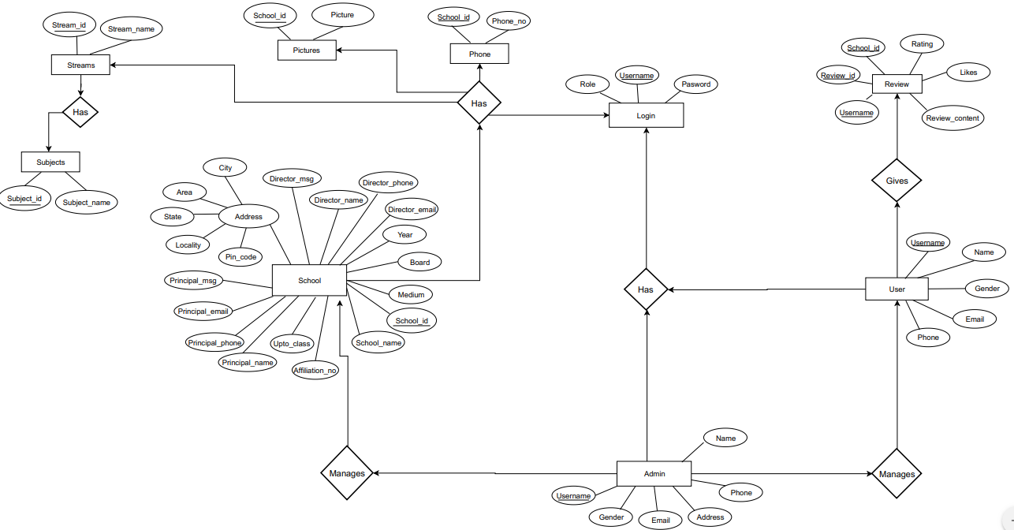
ER Diagram of School Finder.

Slide 9
Requirements
Software Requirement
1.Netbean 2.Web browser such as Google Chrome, Internet Explorer, etc. 3.Java Development Kit (jdk) 4.MySQl client 5.Apache Tomcat or Glassfish server.
6. Sublime-text.
Technology used:
J2EE.
Material Design Bootstrap (MDB).

Slide 10
References
W3schools
Java Tutorial point
Stack Overflow
Font awesome
Material Design Bootstrap (MDB)

Slide 11
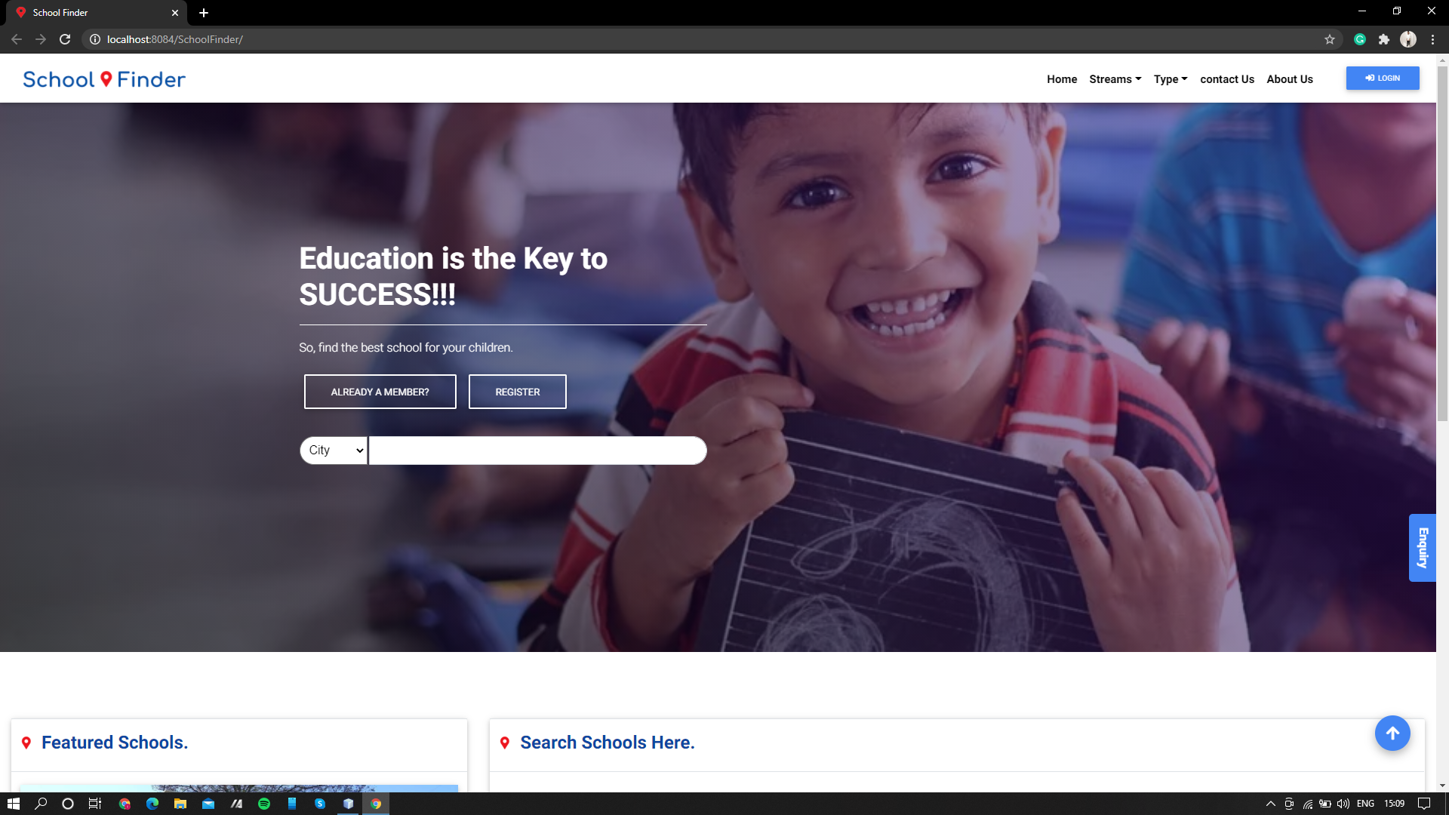
Current Stage Of Implementation 1. School Finder Home Page

Slide 12
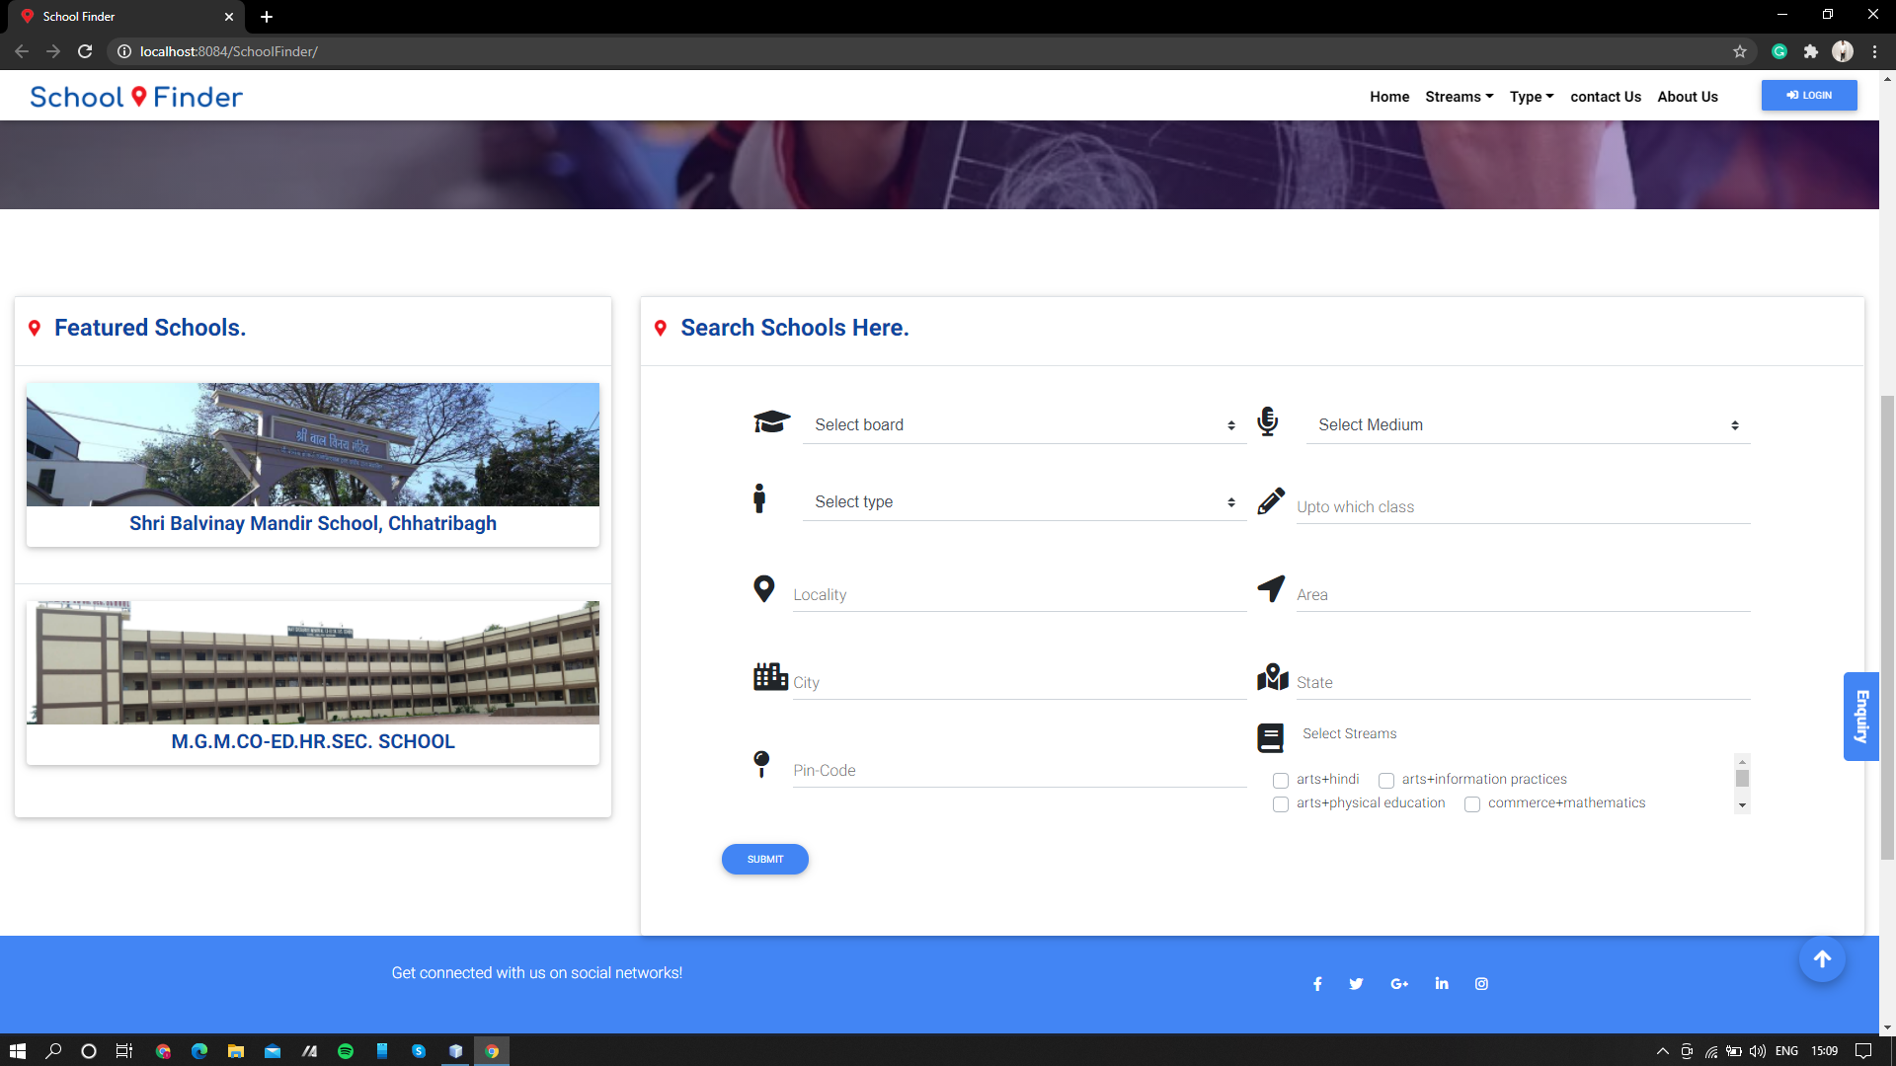
School Finder Home Page contd.

Slide 13
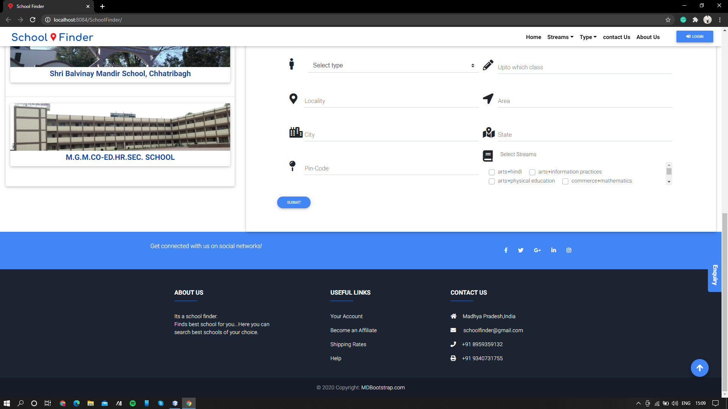
2. School Finder Home Page contd.

Slide 14
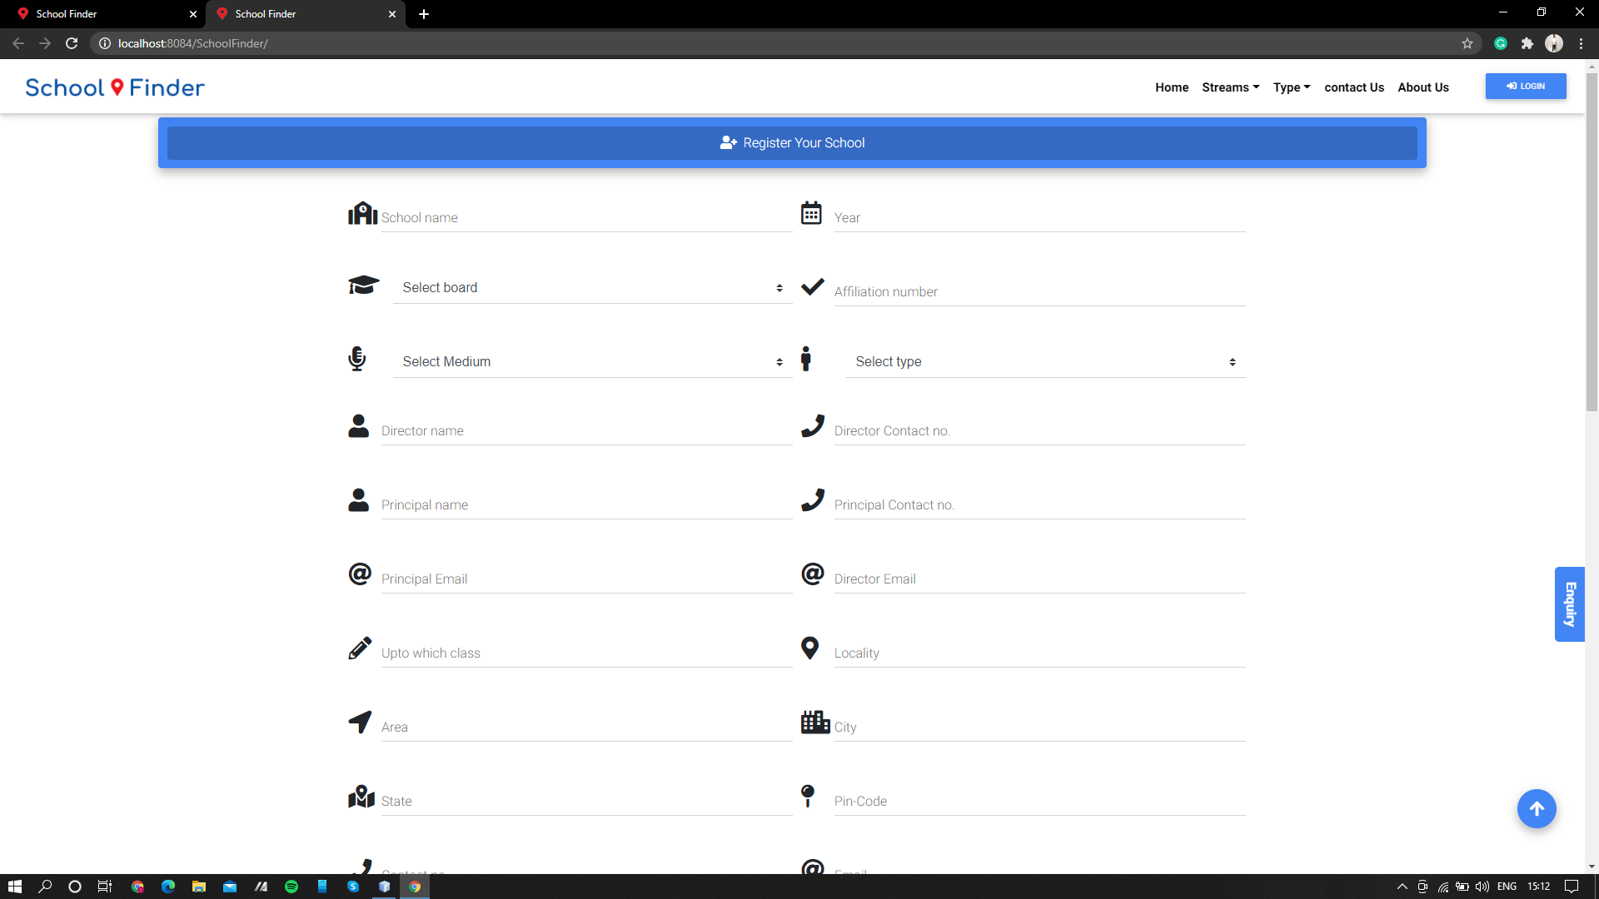
School Registration Page.

Slide 15
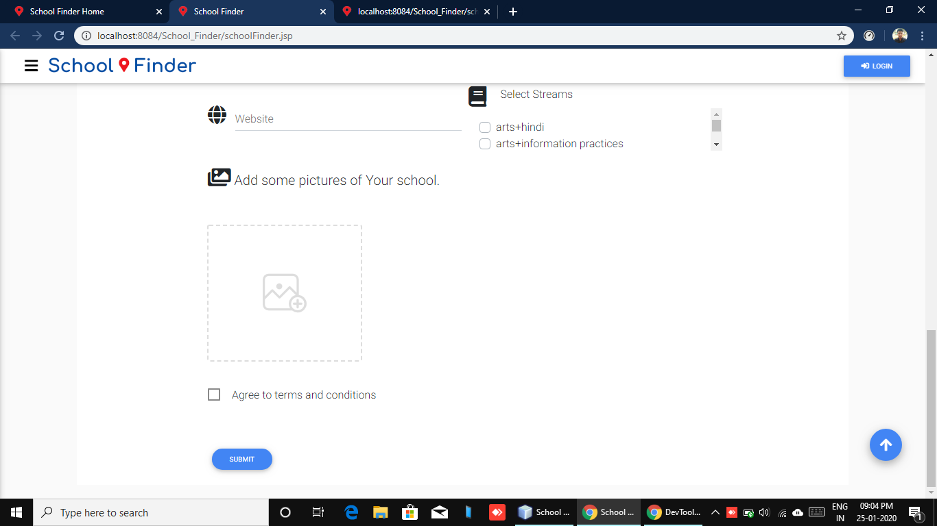
School Registration Page contd.

Slide 16
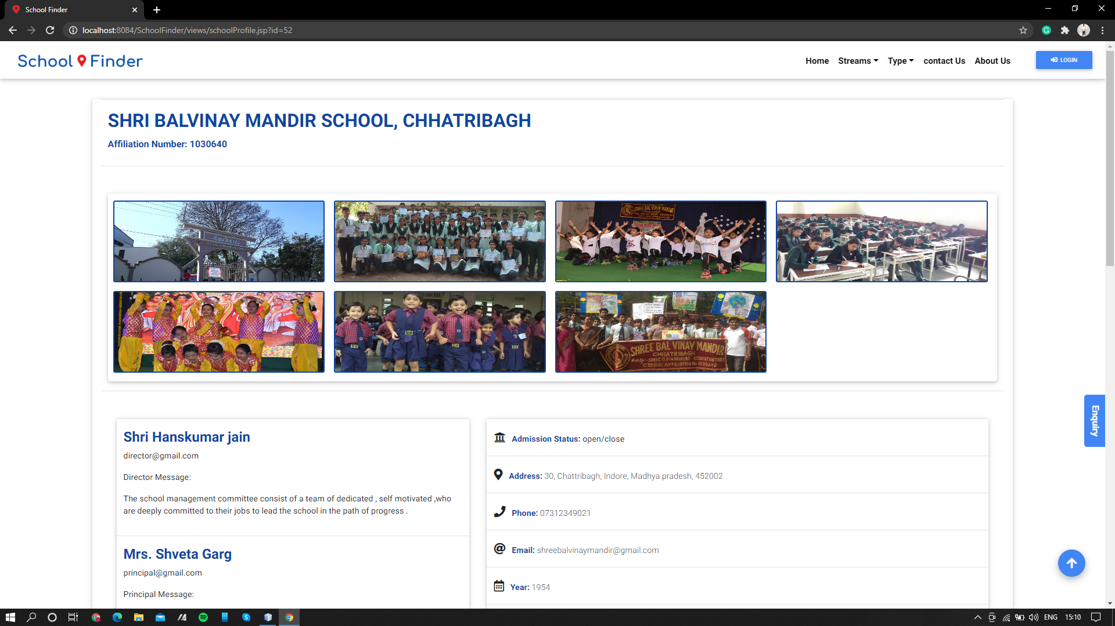
3. School Profile Page.

Slide 17
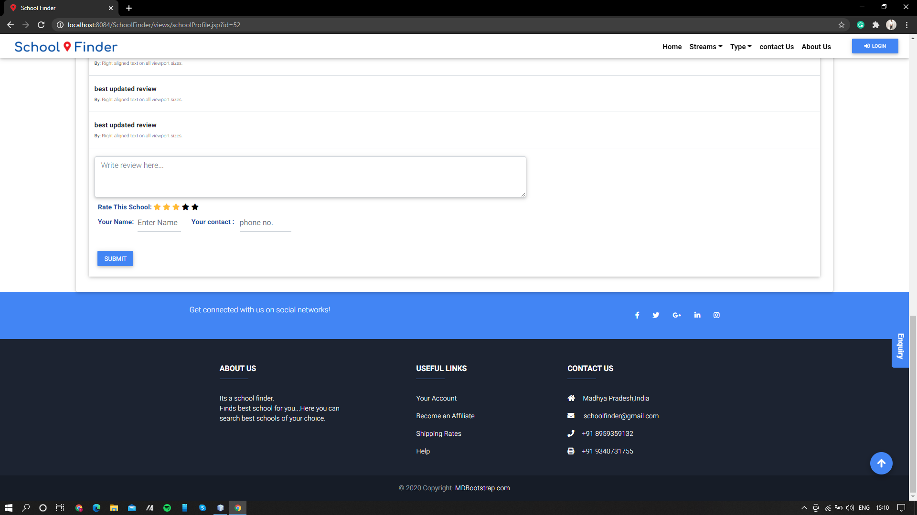
School Profile Page with reviews and rating.

Slide 18
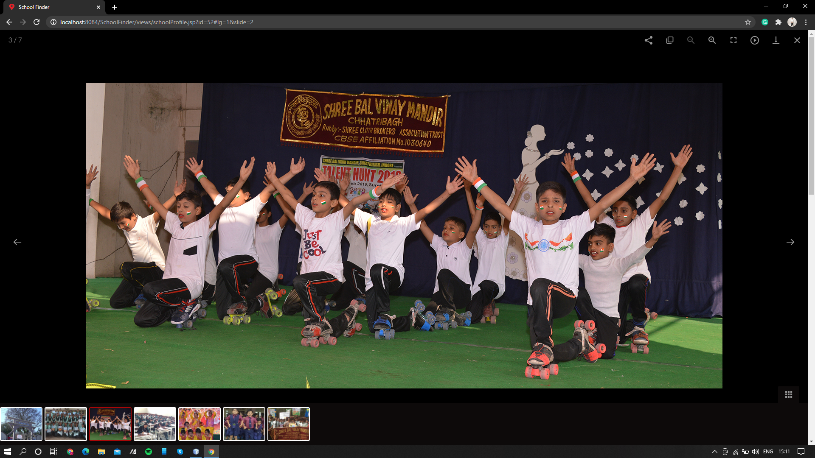
4.Photo gallery of each school.

